Slide 1
Bill Splitter
for Roommates!
Zoe Moccia, Alexander Sirotkin, Lucy Gavrich, Naysa Arora, Niharika Elangovan,
Zainub Waqas (Project Manager)

Slide 2
Table of Contents
01
03
04
02
Frameworks
Function signatures
Endpoints
Testing

Slide 3
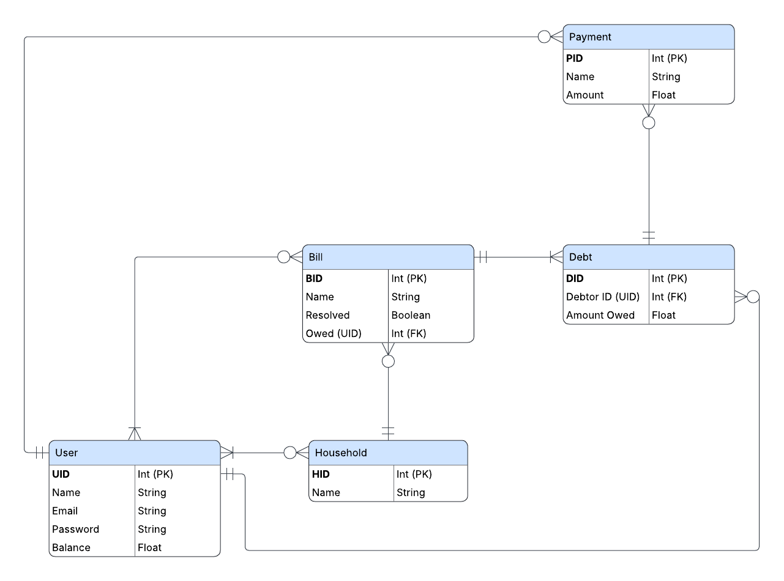
Data Diagram

Slide 4
Frameworks
Django to serve views and manage DB access
SQLite as the DBMS
React for a dynamic front-end

Slide 5
End Point Routes
localhost/login sends login data to backend and gets confirmation
User.checkLogin(email, password)
localhost/getHouseholds will retrieve all households
User.getHouseholds()
localhost/getBills will retrieve all active bills and debts that you are involved in
Household.getBills()

Slide 6
End Point Routes
localhost/getBillsByPerson will retrieve active bills and debts sorted by involved parties
Household.getBillsByPerson()
localhost/getResolved will retrieve all resolved bills and debts that you were involved in
Household.getResolved()

Slide 7
Function signatures
User.checkLogin(string, string): boolean
User.getHouseholds(): Household[]
Household.getBills(): Bill[], Debt[]
Household.getBillsByPerson(): {User: (Bill[], Debt[])}[]
Household.getResolved(): Bill[], Debt[]

Slide 8
Testing
Login
Populate user table with the following data:
user: house@gmail.com password: 1234
user: hold@gmail.com password: 5678
User.checkLogin(house@gmail.com, 1234): True
User.checkLogin(house@gmail.com, 5678): False
User.checkLogin(house@gmail.com, 7777): False
User.checkLogin(person@gmail.com, 1234): False
User.checkLogin(person@gmail.com, 7777): False

Slide 9
Testing
getBills
Household members: Artichoke, Bart, Chad, and Green
Populate bills table with the following data:
B1 (Bill 1)
Creator: Artichoke
Debtors: Green
B2 (Bill 2)
Creator: Bart
Debtors: Artichoke, Green
***Note: Bill entities have more attributes (bid, balance, etc.) but not needed for testing getBills

Slide 10
Testing
getBills
Logged in member: Artichoke
Household.getBills(): [B1], [B2]
Logged in member: Bart
Household.getBills(): [B2], []
Logged in member: Chad
Household.getBills(): [], []
Logged in member: Green
Household.getBills(): [], [B1, B2]

Slide 11
Testing
getBillsByPerson
Let’s take the same household with members: Artichoke, Bart, Chad and Green
We populate Bills table with the same data:
B1 (Bill 1) Creator: Artichoke Debtors: Green
B2 (Bill 2) Creator: Bart Debtors: Artichoke, Green

Slide 12
Testing
getBillsByPerson
Test getBillsByPerson with the following :
Person: Artichoke (When Bart Checks) Bills returned: B2
Household.getBillsByPerson():[B2],[]
Person: Bart (When anyone checks) Bills returned: None
Household.getBillsByPerson():[],[]
Person: Chad (When anyone checks) Bills returned: None
Household.getBillsByPerson():[],[]
Person: Green (When Bart and Artichoke see) Bills returned: B1, B2
Household.getBillsByPerson():[B1],[B2]

Slide 13
Testing
getBillsByPerson
The results of the previous side are only so when a person is checking someone who does owe them money
For example: If the Artichoke gets bills for Green they would be able to see bill as Green owes artichoke money but if Chad were to get bills for green, they would not see anything as green does not owe Chad anything.
So Household.getBillsByPerson(): [],[] (empty array) for anyone who does not owe anything to the person calling this function

Slide 14
Testing
getHouseholds
Show all households a user belongs to. Return empty array if none.
Setup:
Households table:
H1: “131 Apartment” – members: Alice, Bob
H2: “Maple House” – members: Alice, Charlie

Slide 15
Testing
getHouseholds
Test cases:
Logged in user: Alice User.getHouseholds() → [H1, H2]
Logged in user: Bob User.getHouseholds() → [H1]
Logged in user: Charlie User.getHouseholds() → [H2]
Logged in user: Dave (not part of any household) User.getHouseholds() → []

Slide 16
Testing
getResolved
In addition to the existing bills,
B1 (Bill 1)
Creator: Artichoke
Debtors: Green
B2 (Bill 2)
Creator: Bart
Debtors: Artichoke, Green,
add
B3 (Bill 3)
Creator: Green
Debtors: Bart.
Then, let B1 and B3 be resolved.

Slide 17
Testing
getResolved
Logged in member: Artichoke
Household.getResolved(): [B1], []
Logged in member: Bart
Household.getResolved(): [], [B3]
Logged in member: Chad
Household.getResolved(): [], []
Logged in member: Green
Household.getResolved(): [B3], [B1]

Slide 18
Testing
Login
Login with the correct credentials
Login with incorrect credentials
Try to access a Household without logging in
getHouseholds
Show all households that you are part of.
Empty array if user is not part of any household
getBillsByPerson
Show all the bills a particular person has to pay to people of that household
Empty array if the person has no bills to pay

Slide 19
Thank You!

